Slide 1

AVDANCED EXCEL STATISTICS FOR BUSINESS ANALYTICS
Notes:
Welcome!

Slide 2

George Mount
Data Analyst & Educator at Stringfest Analytics
George works as an independent analyst and data analytics educator with the goal to help clients manage their data so they think more creatively. He serves as a technical expert and lead curriculum developer for Thinkful’s data analytics program and is the instructor of the DataCamp course “Survey and Measure Development in R.”
George blogs about data, innovation, and career development at georgejmount.com. He holds a master’s degree in information systems with a certificate of achievement in quantitative methods from Case Western Reserve University
Notes:
Here’s me, you already learned this.

Slide 3

COURSE OBJECTIVES
Model a causal relationship between multiple independent variables and a categorical or continuous dependent variable
Build forecasts that account for trends and seasonality
Use simulation and optimization techniques to model business scenarios
Make compelling business recommendations using inferential statistics
Advanced Excel Statistics for Business Analytics
Notes:
All right, we have a ton of stuff to do today so I apologize now if we don’t get through it all.
This is a follow-up from my Excel Statistics for Business Analytics course, so you should be in good shape for this class. You don’t have to have taken it. But I think it will help.
Pulse check on who’s taken it?
We are going to the next level here on this course. In the last course we focused on descriptive statistics, and then made the leap into inferential statistics with the t-test. And in that test we looked for a statistically significant difference in the means of two values.
We are going to go beyond that now and test things like the differences between three or groups, or the same variable at different points in time. We are also going to get into building a basic predictive model using linear regression, and if you’ve ever heard the discussion about the fine line between correlation and causation, we will see those both here.
As always, I want this to be as business-oriented as possible, we will use real-world datasets, and you will learn how to explain and apply this stuff into a business setting so that our non stats-enlightened counterparts can follow along. And one of the best ways to explain something to someone is to draw a picture, and that’s what we’ll do by building data visualizations throughout. They play a crucial role in interpretation, not just for our audience, but for us – as you’ll see, failing to visualize our data can lead to some pretty wild mis-interpretations.

Slide 4

WHY WOULD WE DO THIS IN EXCEL?
“You get to look at the data every step of the way, building confidence while learning the tricks of the trade.”
-- John Foreman
Advanced Excel Statistics for Business Analytics
Notes:
With the rise of data science programming in R and Python it seems silly to want to do this in Excel but we can really get hands-on this way. We get a lot more up close and personal analysis of the data.

Slide 5
FOLLOWING ALONG
Each section is a sub-folder
Demos = follow along with me
Drills = try it yourself
Refresh your memory with the demo notes
Intermediate Excel Statistics for Business Analytics
Notes:
This is an Excel class, so we won’t be looking at PowerPoint the whole time – to follow along, you will see that all assets are divided by section.
Some of our Excel time will be Demos – for this I will be walking through some procedure in Excel.
If you need any datasets they will be included in each sub-folder.
Then there may be a Drill where you will work on it for yourself during some specified period of time.
I have provided written notes/instructions about the Demos which you can refer to while working on the Drills.

Slide 6
HAVE YOU INSTALLED THE DATA ANALYSIS TOOLPAK?
Notes:
Has everyone done this? If not, check the demo notes and/or follow along with the next two slides.
The steps are different for Mac versus Excel.

Slide 7
ON WINDOWS: ON MAC:
File
Options
Add-ins
Go
Check on Analysis ToolPak
OK
Tools
Excel Add-ins
Check on Analysis ToolPak
Click OK
Notes:
Give me a thumbs up when everyone has this installed.
Open up the wages dataset, we will now summarize a continuous variable (wage) using the Analysis ToolPak.
Another reminder to use the demo notes.

Slide 8
1. REGRESSION ANALYSIS AND PREDICTIVE MODELS
Notes:
All right, we are going to jump right into statistical inference, this section is going to help us say things about a population given our samples, but using different “raw ingredients” than we could us for the t-test.
It’s kind of a grab-bag, and the title “expected values and repeated measures” will start to make more sense as we continue.

Slide 9
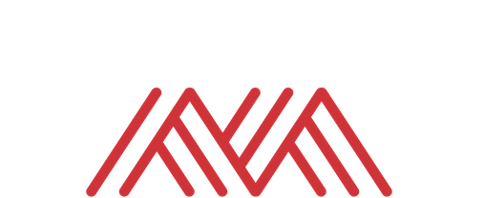
Warm-up
File: mpg-warmup.xlsx
Calculate descriptive statistics and correlations for these variables
There’s always room for descriptive statistics
Notes:
OK, let’s just start by jogging our memory on stats. Take a look at this dataset and let me know in the chat what steps you would take to check for a difference in the price of homes with and without air conditioning.
We performed this exact analysis in the earlier Excel class, so hopefully it’s familiar. As you are thinking through what to do, one of the things you might ask would be, at what confidence interval? Give yourself a pat on the back if you asked that, because it’s a key consideration in inferential statistics! And we will continue to use the 95% confidence interval here.
OK, so we aren’t going to conduct that test since we already did it in the last class. But I do want to use it for a jumping-off point as to other things we might want to learn about the data. Let’s take a look at another possible question.

Slide 10
MULTIPLE LINEAR REGRESSION
Notes:
This is the chi-square test of independence. You will often see it as the Greek letter chi with the exponent 2 sign.

Slide 11
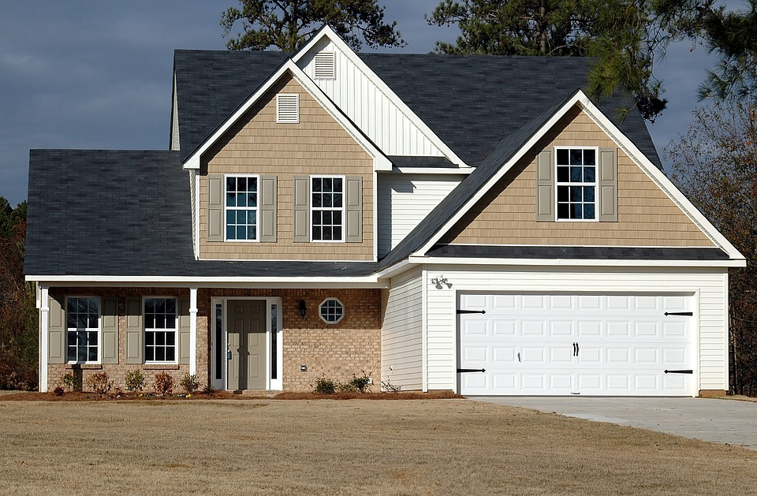

The acorn becomes the oak
How do we measure differences in time across same individuals?
Repeated measures
House at time 1
House at time 2
Intervention (install AC)
Notes:
OK, let’s take a look at another type of statistical test. In the last class we discovered that houses with AC have significantly higher average sales prices than those without.
A similar study would be to measure the sale price of homes without AC. Then install the AC. Then measure the sale price after the installation. This is called repeated measures because we are taking measures of the same observation at individual time points. There is often some intervention between the time points.
Now, in many settings, this is very difficult to conduct a repeated measures analysis, because it’s hard enough to measure these things once, let enough at multiple time points. Could you imagine buying a house, putting in AC, and then flipping it? That would be a very costly experiment with a lot of room for error.
But in some places like healthcare or education, where you are presenting new treatments or methods to your participants, and it’s likely you’ll be able to measure those participants at a later date, this is a common method.
So let’s get into one particular test related to repeated measures.

Slide 12
ASSUMPTIONS
Linear relationship between independent and dependent variable
No influential cases
No multicollinearity
Values of residuals are independent
Variance of residuals is constant
Values of residuals are normally distributed
Notes:
Ok, off to the assumptions like the other tests we’ve done. One is that there is a linear relationship between the variables, we had the same for correlation. Also, no influential cases. The other ones we won’t get into so much. They have to do with the residuals, which you will learn about in a bit.

Slide 13
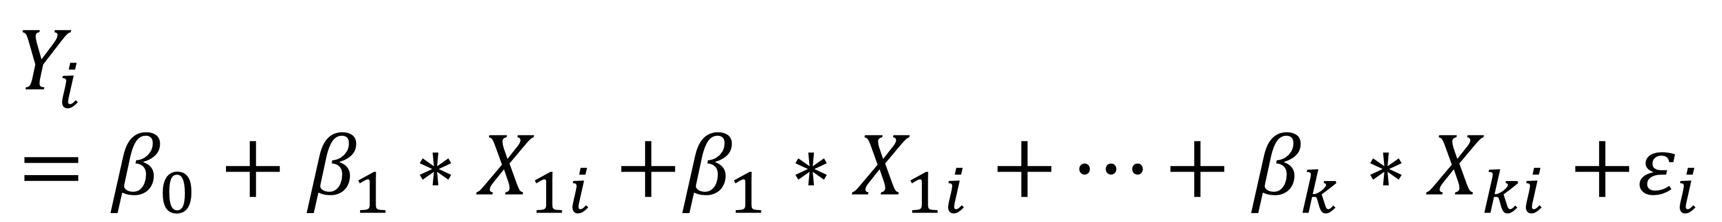
MULTIPLE REGRESSION EQUATION
Dependent / predictor variable
Independent / response variable(s)
Slope coefficient(s)
Y intercept
Error term(s)
$$Y_{i}=β_{0}+β_{1}{∗X}_{1i}+β_{1}{∗X}_{1i}+…+β_{k}{∗X}_{ki}+ε_{i}$$
Notes:
Again, we are predicting Y with a straight line. This line will have three components – first is going to be the y intercept. Then we will find a coefficient of the slope multiplied by our independent variable.
Then there will be some random error. This is the variation in the dependent variable that our independent variable doesn’t explain.

Slide 14
HYPOTHESES
Ho: No relationship between X’s and Y. The slope equals zero.
Ha: A relationship between X’s and Y. The slope does not equal zero.
Notes:
Now, the hypotheses. Again, it’s all about this fitted line. If the slope of the line is equal to zero, we really can’t say how 1 unit of X influences Y.
Now, there is a series of steps, or an algorithm to use the fancy word, used to actually fit that line, but we will let Excel do it for us. And we will get something like the next slide.

Slide 15
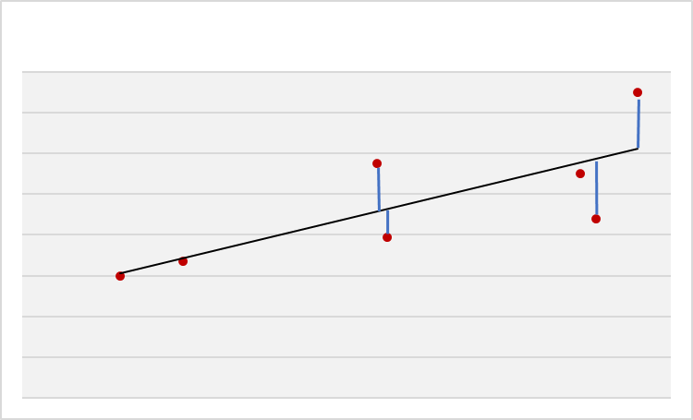
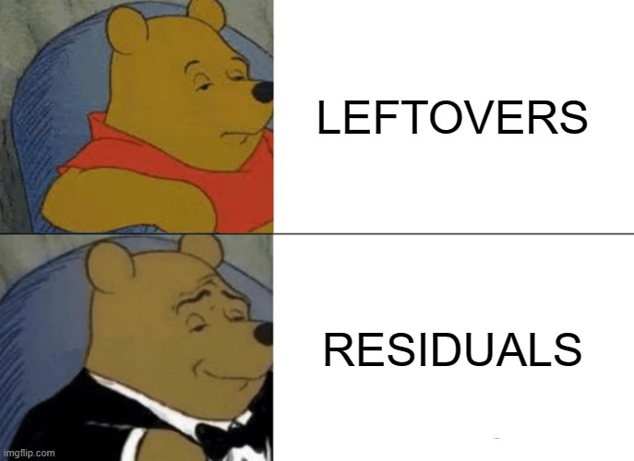
$$Residual=Y−\hat{Y}$$
Observed value
Estimated value
Notes:
Now, here is a pretty small scatter plot where we have fitted a line between these points. We have our actual points from the scatter plots, and the estimates based on where those X values fit on the line. This is the difference between the actual, and the estimated, and this is the residual. You can think of it as the leftover between the scatterplot and the line.

Slide 16
LOGISTIC REGRESSION
Notes:
This is the chi-square test of independence. You will often see it as the Greek letter chi with the exponent 2 sign.

Slide 17
ASSUMPTIONS
Binary dependent variable
Observations are independent
No multicollinearity
Large sample size
Linearity of independent variables and log odds
No influential cases
Notes:
Ok, off to the assumptions like the other tests we’ve done. One is that there is a linear relationship between the variables, we had the same for correlation. Also, no influential cases. The other ones we won’t get into so much. They have to do with the residuals, which you will learn about in a bit.

Slide 18
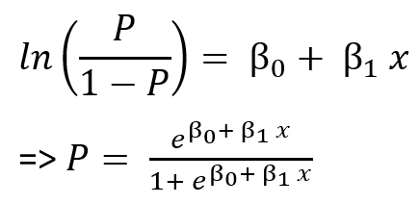

LOGISTIC REGRESSION EQUATION
Independent / response variable(s)
Y intercept
Slope coefficient(s)
Dependent / predictor variable
(expressed in probability)
$$P=\frac{e^{β0+ β1∗x1i+…+βk∗xki}}{1+e^{β0+ β1∗x1i+…+βk∗xki}}$$
Notes:
Again, we are predicting Y with a straight line. This line will have three components – first is going to be the y intercept. Then we will find a coefficient of the slope multiplied by our independent variable.
Then there will be some random error. This is the variation in the dependent variable that our independent variable doesn’t explain.

Slide 19
HYPOTHESES
Ho: No relationship between X’s and Y. The Y values you predict are no closer to the actual Y values than you would expect by chance.
Ha: A relationship between X’s and Y. The slope does not equal zero. The Y values you predict are closer to the actual Y values than you would expect by chance.
Notes:
Now, the hypotheses. Again, it’s all about this fitted line. If the slope of the line is equal to zero, we really can’t say how 1 unit of X influences Y.
Now, there is a series of steps, or an algorithm to use the fancy word, used to actually fit that line, but we will let Excel do it for us. And we will get something like the next slide.

Slide 20
4. CONCLUSION
Notes:
All right, we are at the end of our whirlwind tour! Here is some future learning for you and some things to check out on the O’Reilly learning platform.

Slide 21
Future learning
Continue exploring linear regression
Assumptions
Multiple regression
Regression with categorical variables
Logistic regression
Simulation and optimization
Notes:
Now, if you wanted to take your learning to the next level, here are some things to do.
First would be to get deeper into linear regression. We didn’t do much with things like removing outliers or examining the residuals. But you really want to get that stuff down.
We also only modeled a regression with one independent variable. You can have several and that’s called multiple regression. And those independent variables can even have categorical variables, for example you could use whether a car has some premium feature (yes or no) to predict its mileage.
Once you’ve got linear regression down, you can move onto logistic regression. Now this is a way to model the influence of independent variables on a binary dependent variable, such as whether a customer will buy or not buy.
Then you can get into simulation and optimization methods. These techniques are built on many of the statistical principles we’ve covered in this class and are very applied. They work great in Excel.

Slide 22
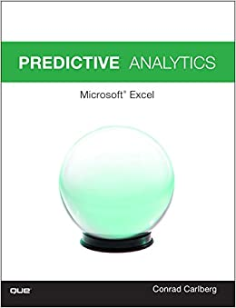
Predictive Analytics: Microsoft Excel, by Conrad Carlberg
On O’Reilly Learning at https://learning.oreilly.com/library/view/predictive-analytics-microsoft/9780134682921/
Human Centered Design • MDLS 2020
Notes:
Here is some further reading. Now that you’ve learned linear regression, you start to enter the realm of predictive analytics and this is a great book for that in Excel. It’s got some chapters digging in on linear regression as I suggested you do and then covers some other important topics.

Slide 23
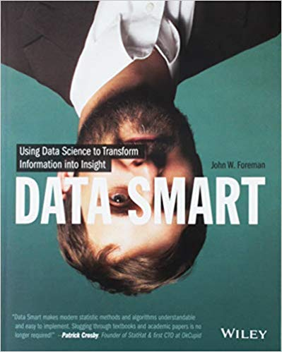
Data Smart: Using Data Science to Transform Information into Insight,
by John Foreman
On O’Reilly Learning at https://learning.oreilly.com/library/view/data-smart-using/9781118661468/
Human Centered Design • MDLS 2020
Notes:
This is a more “modern” approach to statistical analysis in Excel and will show you techniques like clustering, naïve Bayes, and things that you might not have thought possible in Excel, but again by learning them in Excel you get a really hands-on look at how these algorithms work that you may not necessarily get in R or Python (I quoted from this book way at the beginning in explaining why we would want to learn this stuff in Excel!)
The final chapter of this book does show you how to move into R from spreadsheets which is not a bad idea when you want to “productionize” what you have learned, but spreadsheets are really an awesome learning tool.

Slide 24
LET'S TALK
LINKEDIN
linkedin.com/in/gjmount
EMAIL ADDRESS
george@stringfestanalytics.com
WEBSITE
stringfestanalytics.com
GITHUB
github.com/summerofgeorge
Notes:
Thanks for coming! Feel free to contact me anytime, find me on LinkedIn, I also write frequently on this stuff so check out my website too.

Slide 25
QUESTIONS?
Notes:
Any final questions?

